Slide 1

Department of Computer Applications
MCA VI SEM
Stock Prediction & Visualizer
Project VIVA
Submitted To
Dr. U Srinivasulu Reddy
Submitted By
Yashraj (205121107)

Slide 2
Stock Prediction & Visualizer

Slide 3
Table Of Content
Introduction
Problem Statement
Working Of Model
Methodologies
Implementation & Explanation
Results
Future Scope

Slide 4
Introduction
Stock Prediction: Stock prediction involves forecasting future stock prices based on historical data and various analytical methods. It utilizes statistical models and machine learning techniques, such as Long Short-Term Memory (LSTM) networks, to identify patterns and trends within stock market data. The goal of stock prediction is to provide investors and traders with insights that can aid in making informed decisions about buying or selling stocks.
Visualizer: A visualizer in the context of stock prediction is a tool or system that graphically represents stock data and prediction results. It uses charts and graphs to display historical stock prices alongside predicted prices, allowing users to easily interpret and compare the data. Visualization tools enhance the understanding of model performance and the accuracy of predictions, making the analysis more accessible and actionable.

Slide 5
Problem Statement?
The financial markets are complex and volatile, making accurate stock price predictions difficult. Investors need reliable tools to forecast price movements and visualize trends to make informed decisions. “This project aims to develop a tool that uses machine learning algorithms to predict stock prices based on historical data." It will also provide detailed visualizations of market trends, enabling users to understand and act on these predictions effectively. The goal is to enhance prediction accuracy and offer a user-friendly platform for real-time market analysis.

Slide 6
Working Of Model

Slide 7
Data collection and Preprocessing:
The first step is gathering relevant data. This includes:
Historical Stock Prices: Daily, weekly, or monthly stock prices (open, high, low, close, and volume).
Market Indicators: Indices like S&P 500, Dow Jones Industrial Average.
External Factors: News articles, social media sentiment, economic indicators.
Raw data is rarely in a form suitable for direct use in algorithms.
Preprocessing steps include:
Normalization: Scaling data to a specific range (e.g., [0, 1]) using techniques like MinMaxScaler.
Feature Engineering: Creating new features or selecting relevant ones to improve model performance.

Slide 8
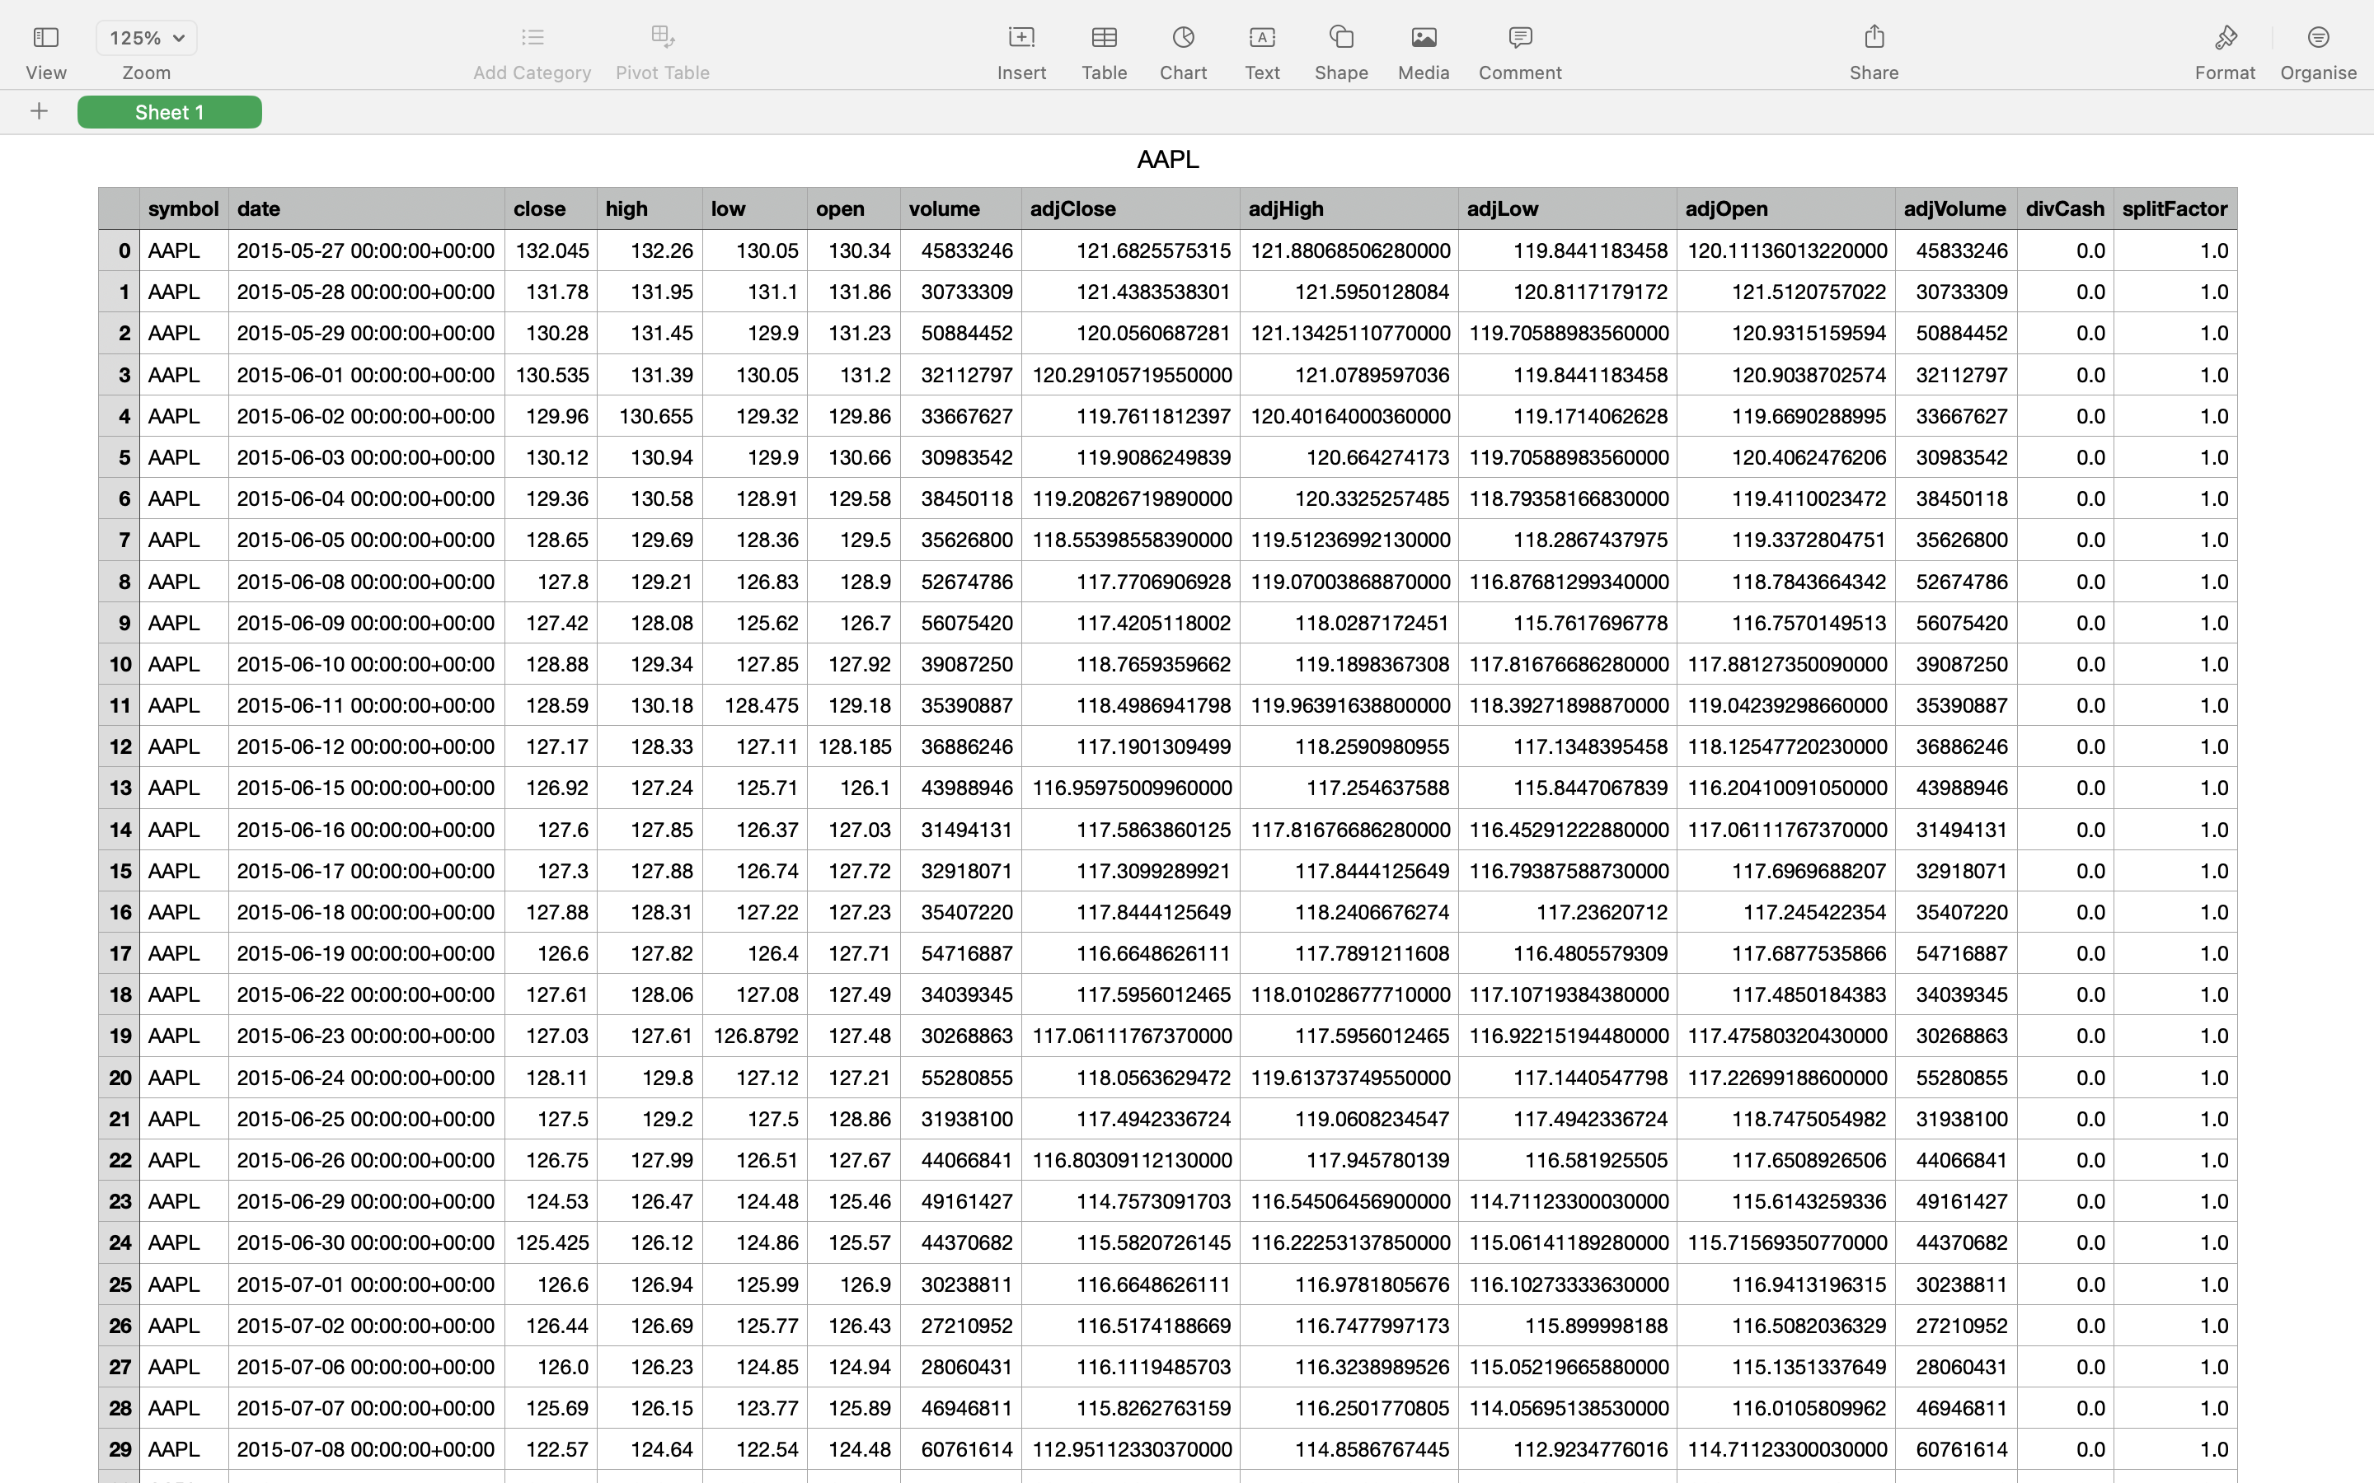
“AAPL Dataset”

Slide 9
Training and Prediction:
Training the chosen model involves several steps:
Data Splitting: Dividing the data into training, validation, and test sets to evaluate model performance.
Hyperparameter Tuning: Hyperparameters include learning rate, batch size, number of layers, activation functions, etc.
Optimization: Using optimization algorithms like Adam, which adjusts learning rates during training for faster and more efficient convergence.
Prediction Phase steps include:
Model Loading: Load the trained model parameters saved during the training phase.
Inference: Feed the pre-processed input data into the trained model to obtain predictions.

Slide 10
Methodologies Includes

Slide 11
Long Short-Term Memory (LSTM)
LSTMs Long Short-Term Memory is a type of RNNs Recurrent Neural Network that can detain long-term dependencies in sequential data.
LSTMs can process and analyze sequential data, such as time series, text, and speech.
They use a memory cell and gates to control the flow of information, allowing them to selectively retain or discard information as needed and thus avoid the vanishing gradient problem that plagues traditional RNNs. “

Slide 12
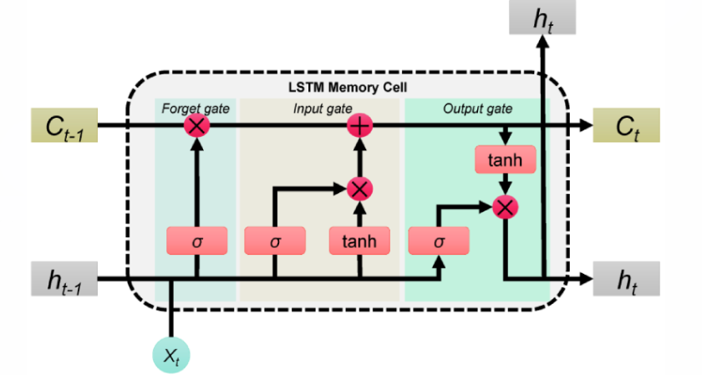
There are three types of gates in an LSTM: the input gate, the forget gate, and the output gate.
The input gate controls the flow of information into the memory cell. The forget gate controls the flow of information out of the memory cell. The output gate controls the flow of information out of the LSTM and into the output.

Slide 13
Adaptive Moment Estimation (Adam) is an algorithm for optimization technique for gradient descent. The method is efficient when working with large problem involving a lot of data or parameters. It requires less memory and is efficient. Intuitively, it is a combination of the ‘gradient descent with momentum’ algorithm and the ‘RMSP’ algorithm.
Adam optimizer involves a combination of two gradient descent methodologies:
Momentum:
This algorithm is used to accelerate the gradient descent algorithm by taking into consideration the ‘exponentially weighted average’ of the gradients. Using averages makes the algorithm converge towards the minima in a faster pace.
Root Mean Square Propagation (RMSP):
Root mean square prop or RMSprop is an adaptive learning algorithm that tries to improve AdaGrad. Instead of taking the cumulative sum of squared gradients like in AdaGrad, it takes the ‘exponential moving average’.

Slide 14
Implementation & Explanation

Slide 15
Data Collection:
Obtain historical stock price data from various sources like Yahoo Finance, Alpha Vantage, or Quandl. You'll typically need data on open, high, low, close prices (OHLC), and volume. Consider factors like dividends, stock splits, and other corporate actions that may affect the data.
Data Pre-processing :
Clean the data by handling missing values, removing outliers, and adjusting for stock splits or dividends. You might also need to normalize or scale the data to improve model performance.
Feature Engineering :
Extract relevant features from the raw data that could potentially influence stock prices. These could include technical indicators (e.g., moving averages, RSI), fundamental data (e.g., earnings per share, P/E ratio), and sentiment analysis from news or social media.
Model Selection & Training :
Choose an appropriate machine learning or deep learning model for stock prediction. Common choices include linear regression, ARIMA, LSTM, or more advanced algorithms like Gradient Boosting Machines (GBM) or Long Short-Term Memory (LSTM) networks.
Split your data into training and testing sets. Train your model on the training data and tune hyperparameters to optimize performance.

Slide 16
Model Evaluation:
Evaluate your model's performance using metrics like Mean Absolute Error (MAE), Root Mean Squared Error (RMSE), or accuracy. Compare the predicted values against actual values on the test set to assess how well your model generalizes to unseen data.
Visualization:
Develop a user-friendly visualization interface to display stock prices, predicted values, and any relevant features or indicators. Tools like Matplotlib, Plotly, or Bokeh can be used to create interactive charts and dashboards.
Monitoring and Maintenance:
Continuously monitor your model's performance in the real world and update it as needed. Markets are dynamic, so your model may need periodic retraining or adjustment to remain accurate.

Slide 17
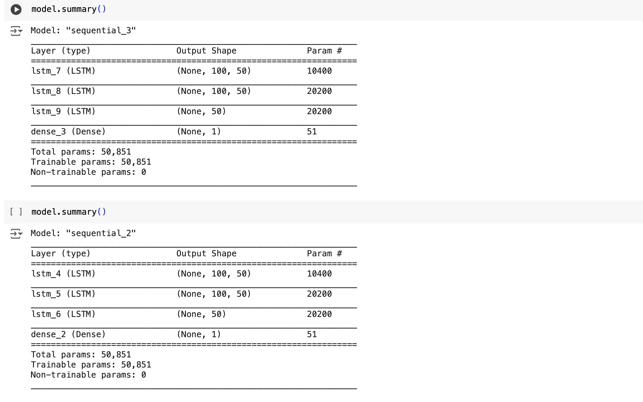
The "sequential_3" model for predicting AAPL stock prices utilizes three Long Short-Term Memory (LSTM) layers to capture temporal dependencies in the data, followed by a dense layer for final prediction. The first two LSTM layers, each with 50 units, return sequences and capture complex patterns over time, while the third LSTM layer distills these patterns into a single output. The dense layer then produces the final stock price prediction. With a total of 50,851 trainable parameters, this architecture is designed to effectively learn from historical data and make accurate predictions, even in volatile market conditions like those observed in 2020.

Slide 18
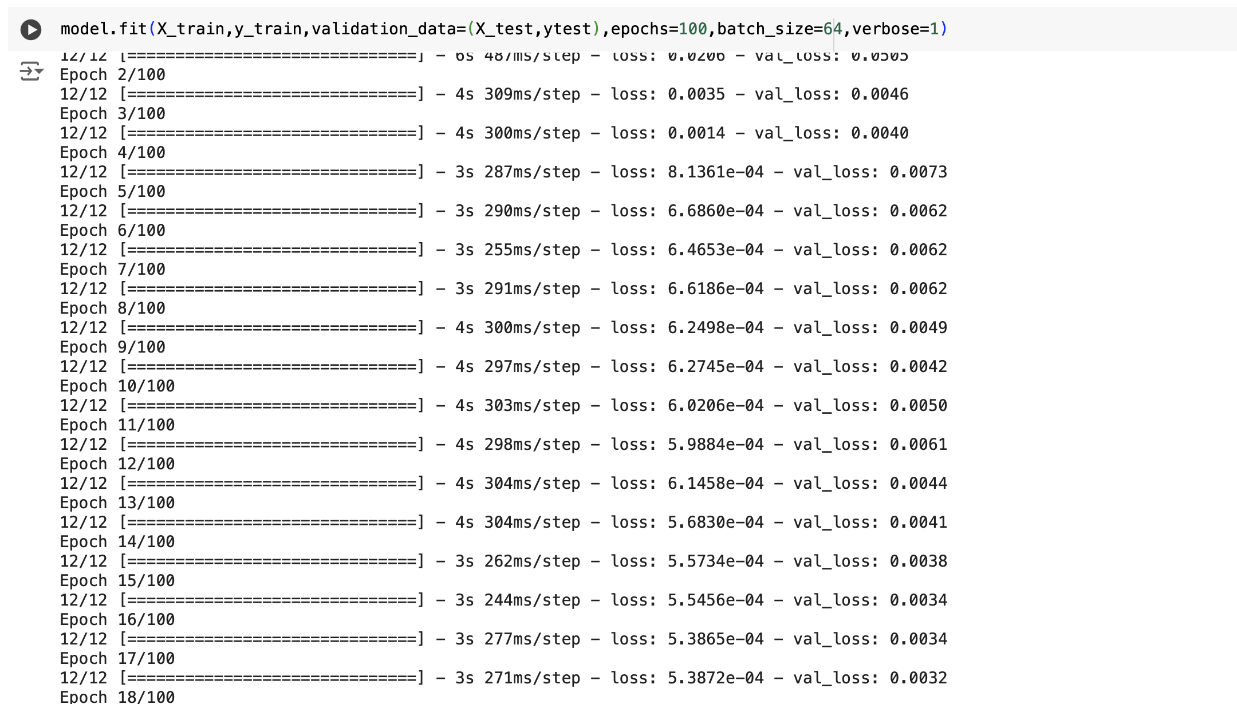
The training process involved 100 epochs to predict AAPL stock prices using an LSTM model. Initially, the model's performance was suboptimal, with higher losses on the validation data compared to the training data. However, as training progressed, both training and validation losses steadily decreased, indicating the model's learning and improved ability to generalize. Fluctuations in validation loss during middle epochs suggested occasional difficulties in handling unseen data patterns. Ultimately, the model converged to low training and validation losses, around 0.0001 and 0.0009 respectively, demonstrating its accuracy and robustness in predicting AAPL stock prices.

Slide 19
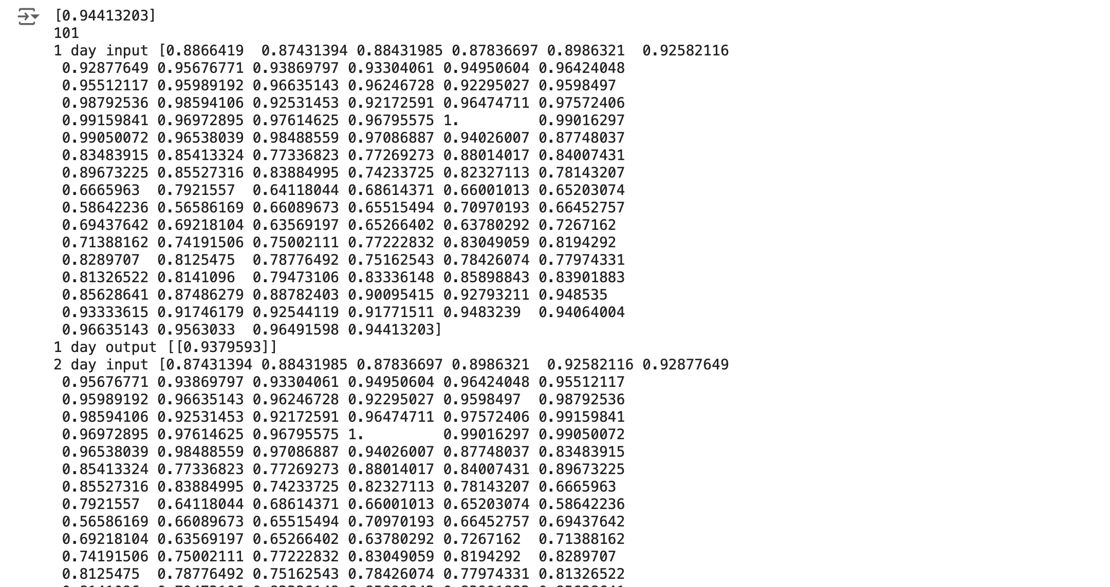
This section demonstrated the prediction of stock prices for the next 10 days using a trained machine learning model. The process involved preparing historical stock price data, training a machine learning model, and applying it to make forecasts. Key steps included data preprocessing, model training, prediction procedure, evaluation, and visualization of predicted stock prices. By showcasing the capabilities of machine learning models in forecasting financial time series data, this section highlights their potential utility for informing investment decisions.

Slide 20
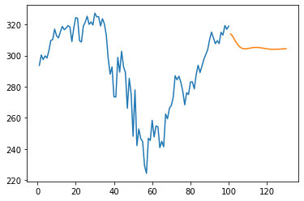
Actual Data (Blue Line): The blue line represents the actual AAPL stock prices from the dataset, starting from index 278 onwards. This portion of the graph shows the historical trends and fluctuations in the AAPL stock prices.
Predicted Data (Orange Line): The orange line represents the predicted AAPL stock prices generated by the LSTM model. It illustrates the model's forecast for future stock prices based on the historical data provided. Comparing the orange line with the blue line allows for an assessment of the model's predictive accuracy. A close alignment between the two lines suggests that the model effectively captures the underlying patterns in the data and makes accurate predictions.

Slide 21
Future Scope
Incorporating Alternative
Data Sources
Deep Learning
Architectures
Real-time Data
Processing
Explore the integration of alternative data sources such as satellite imagery, social media sentiment, or macroeconomic indicators to enhance the predictive power of models. Utilize natural language processing (NLP) to extract insights from textual data sources.
Experiment with more complex deep learning architectures beyond traditional LSTM networks, such as attention mechanisms, transformer models (e.g., BERT), or graph neural networks, to capture intricate relationships in financial data.
Build systems capable of processing and analysing streaming data in real-time, enabling timely insights and adaptive trading strategies. Leverage cloud computing platforms and distributed computing frameworks to handle large volumes of data

Slide 22
THANKS!
Any Questions?

